Slide 1

Recipe Finder
Presented by:
Nguyễn Văn Nguyễn - 23521053
Trương Mạnh Nguyên - 23521065
December 2, 2025

Slide 2





Agenda
1. Motivation
5. Authentication
2. Features
6. Backend
3. Architecture
7. Frontend
4. Database
8. Deployment
Helps users find recipes, plan meals, and manage shopping.

Slide 3



1. Motivation
User’s problem
Users struggle daily to decide what to eat.
Users do not know how to cook.
Recipe sources are scattered, hard to save/reuse
No nutrition tracking
Our solution
An all-in-one website that brings together the features users need:
searching recipes
saving favorites
planning meals
generating shopping lists

Slide 4
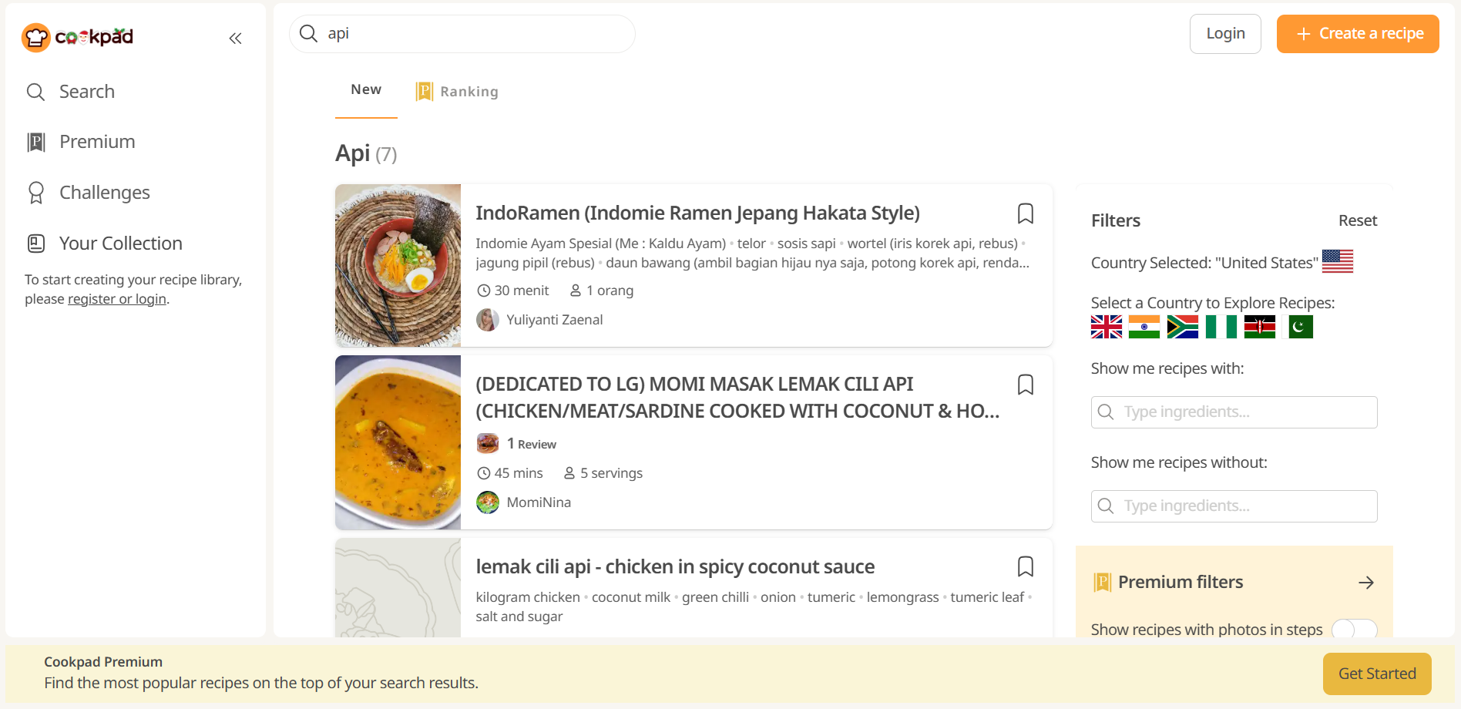
REFERENCE WEBSITE: cookpad.com

Slide 5


1. Motivation
To answer: Why we choose to do this web?
Helps users find recipes
Control calorie intake
Plan maker
Shopping list

Slide 6

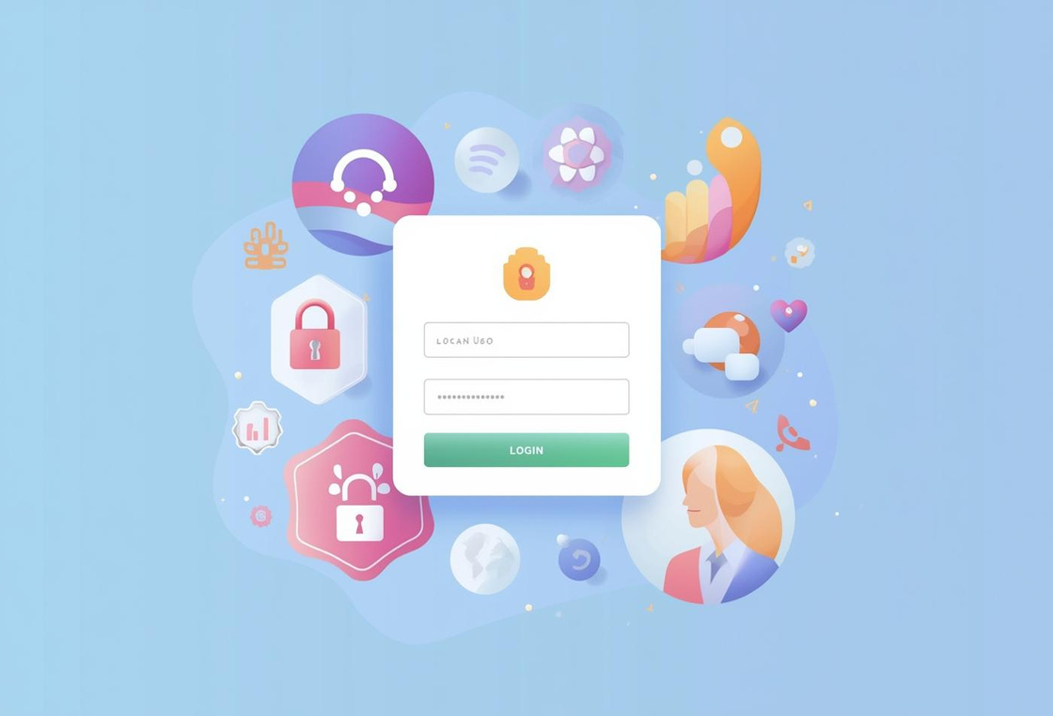
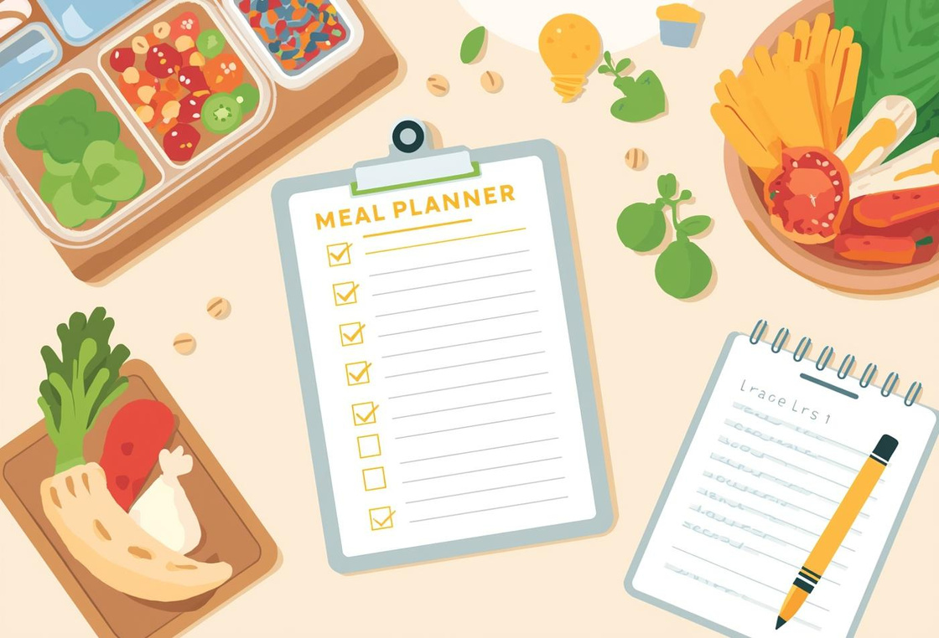
2. Features
Discover Recipes
Authenticate Sign Up and Login
Meal Planner and Manage Shopping Effortlessly
Explore Recipes
Join Us Now
Get Started

Slide 7

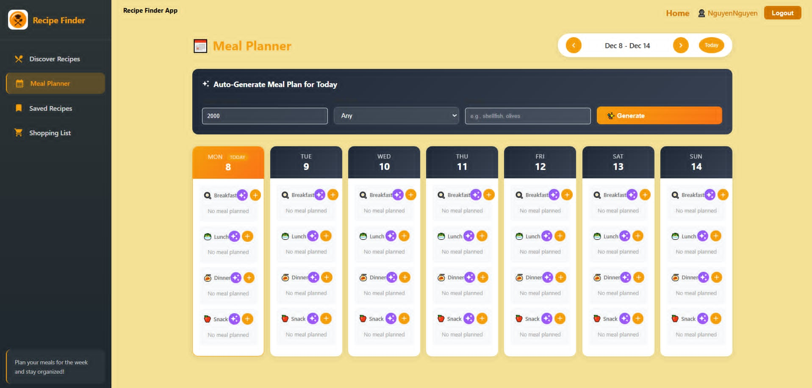
Meal Planner - Unique Feature

Slide 8
3. System Architecture
Frontend
OVERALL ARCHITECTURE
React 18, Router, Context API, Axios
SMTP / Mail Server
Backend
External APIs
verify / reset emails
Node.js + Express, JWT, Nodemailer.
Spoonacular (recipes), Edamam (nutrition).
Database
MySQL

Slide 9

4. Database
USERS Table
FAVORITES Table
Stores essential user information (userID, userName), including email, password hash, verification status, and reset tokens.
Contains user-specific saved recipes, including recipe IDs, titles, and associated images for easy access.
MEAL_PLANS Table
SHOPPING_LISTS Table
Tracks weekly meal plans with user IDs, meal types, and associated recipe information for organization.
Manages grocery items with names, quantities, units, and checked status for efficient shopping experiences.

Slide 10


5. Authentication
User Sign-Up
Email Verification
Login Block
The sign-up process creates a new user account.
A verification email is sent with a secure token.
Login access is restricted for unverified email addresses.
Forgot Password Flow
Reset Password
Security Measures
Users can request a reset token via email.
New passwords may only be set with a valid token.
The process uses tokens to protect user account integrity.
10

Slide 11
6. Backend Overview
Validation
Structure
User input is validated, ensuring accurate data processing.
The backend includes server.js and db.js for connections.
JWT Middleware
Emails
Middleware checks tokens to protect private routes effectively.
Nodemailer sends verification and reset emails with tokens.
11

Slide 12


7. Frontend
Folder Organization
Axios Instance
Global State
The project structure is organized under the src/ directory.
API calls use an Axios instance for simplified requests.
Auth and UI states are managed using Context APIs.
Pages Included
Public/Protected Routes
The application has multiple pages for various functions.
Routes are separated for public and authenticated user access.
12

Slide 13





8. Deployment
vercel.com
render.com
Front-End
Back-End
aiven.io
github.com
Database
GitHub
13

Slide 14


Thank you!
REFERENCES:
https://cookpad.com/eng/search/api
https://spoonacular.com/food-api
PROJECT URLs:
https://github.com/BeerusNguyen/MSIS207.Q14.CTTT.BE
https://github.com/BeerusNguyen/MSIS207.Q14.CTTT.FE
https://recipe-backend-xu20.onrender.com/api-docs
https://recipe-finder-group-19.vercel.app/
Username: NguyenNguyen
Password: Khacnhaok
For more information, please contact us at 23521065@gm.uit.vn

